Slide 1
Submitted By: Sanjatul Hasan Siam (ASH1925023M) Nadia Islam (BKH1925006) Abdullah Al Tahmid (ASH1925014M)
Collection Frame work
Submitted To:
Falguni Roy
Assistant Professor , IIT, NSTU

Slide 2
Contents
1.Collection framework overview.
2.Interfaces of collection framework
3.Classes of collection framework.
4.Methods of collection framework.

Slide 3
What is Collection Frame work?
Collection :
Collection is a group of objects as a single entity.
Collection Frame work :
Collection frame work defines several classes and interfaces which can be used to represent a group of object as a single entity (Collection).

Slide 4
Why collection frame work is needed?
To overcome the limitation of Arrays we need Collection Frame Work.

Slide 5
Limitation of Array
Arrays are fixed in size. Ex- int array[100];
Array can hold only homogenous data.
Readymade methods supports are not available in Array, as there is no underlying data structure in Array.

Slide 6
Array Vs Collection Frame work
Array | Collection Frame Work
1.Fixed in size | 1.Growable in nature
2.With respect to memory it is recommended | 2.With respect to memory it is not recommended
3.Hold only homogenous data | 3.Hold both homo and heterogeneous data
4.Readymade methods are not available | 4.Readymade methods are available
5.With respect to performance it is recommended | 5.With respect to performance it is not recommended
6.Can hold both primitives and object data | 6.Can hold only object data

Slide 7
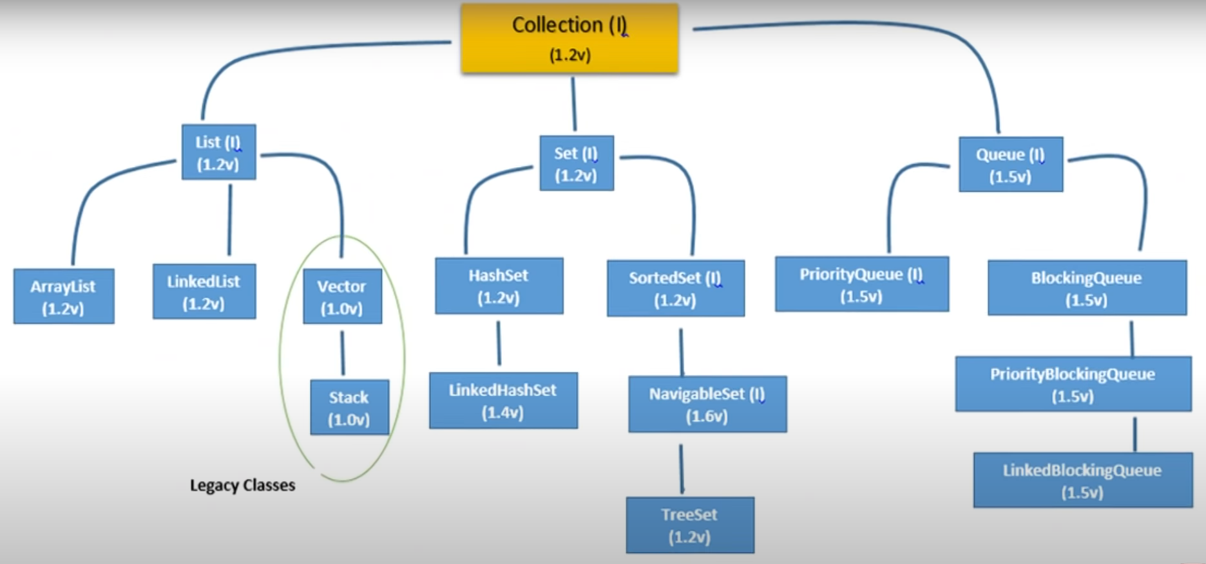
Collection Overview

Slide 8
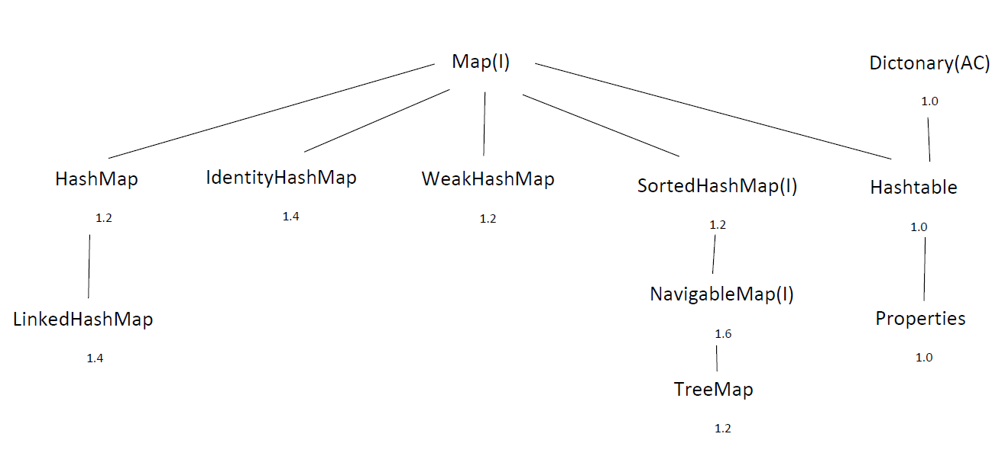
Collection Overview

Slide 9
Key interfaces of : (1)Collection
Collection : Collection interface defines most common methods which are applicable for any collection object.
Ex- add(),remove()

Slide 10
Collections
Collections is a utility class which defines several utility methods for collection objects.
Ex- ArrayList al = new Arraylist();
al.add(10);
al.add(23);
al.add(3);
Collections.sort(al);

Slide 11
(2) List Interface
Child interfaces of collection
1.Duplicate are allowed
2.Insertion order is preserved

Slide 12
Implementation class of List
There are four implementation classes of List interface :
1.Array(version 1.2)
2.LinkedList(Version 1.2)
3.Vector(1.0)
4.Stack(1.0)

Slide 13
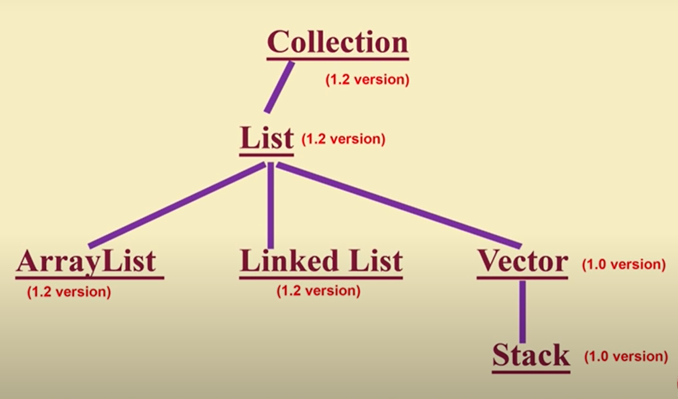
Implementation class of List

Slide 14
Methods Of Collection Interface
boolean add (Object o) | boolean cotains (Onject o)
boolean addAll (Collection c) | boolean containsAll (Collection c)
boolean remove (Object o) | boolean isEmpty ()
boolean removeAll (Collection c) | Int size ()
boolean retainAll(Collection c) | Object[] toarray()
Void clear () | Iterator iterator()

Slide 15
List interface : Methods
void add (int index , Object o) | object get (int index)
boolean addAll (int index , Collection c) | int indexOf (Object o)
object remove (int index) | int lastIndexOf (Object o)
object set (int index , Object new) | listIterator listIterator ()

Slide 16
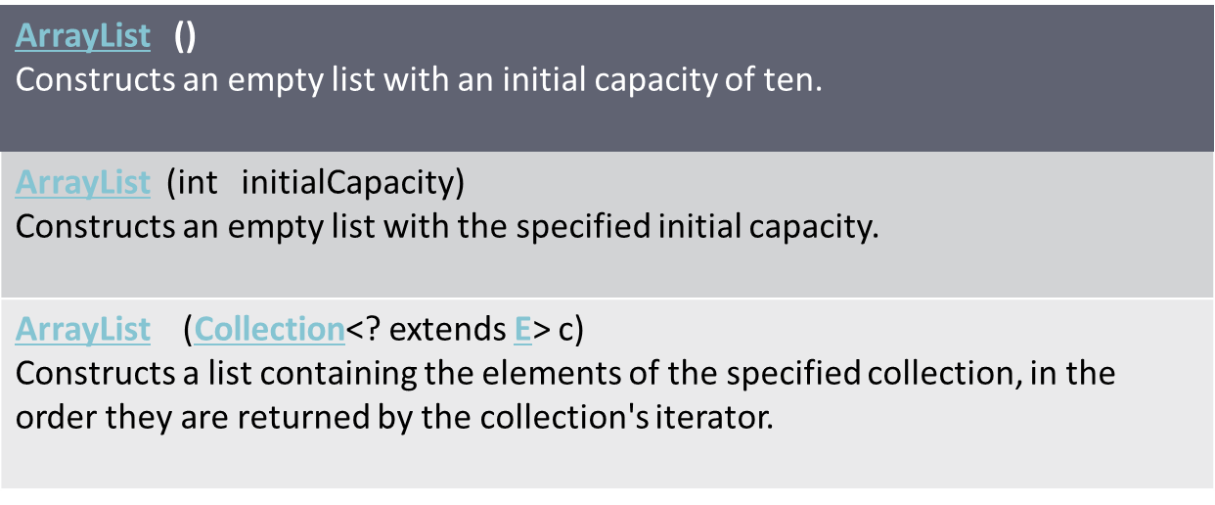
ArrayList Class
Constructor : There are three constructor in ArrayList class.

Slide 17
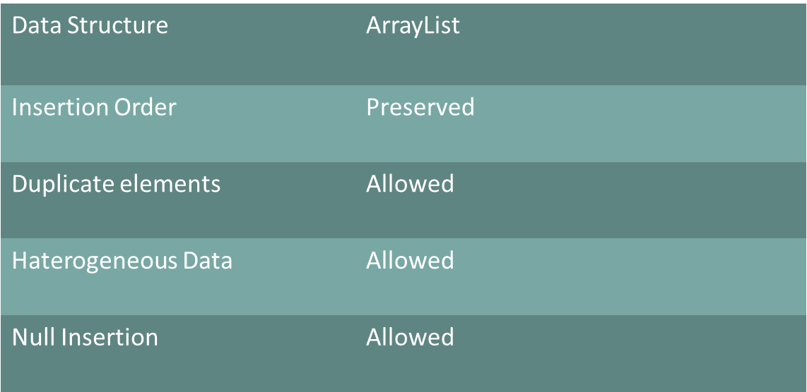
ArrayList Class : properties

Slide 18
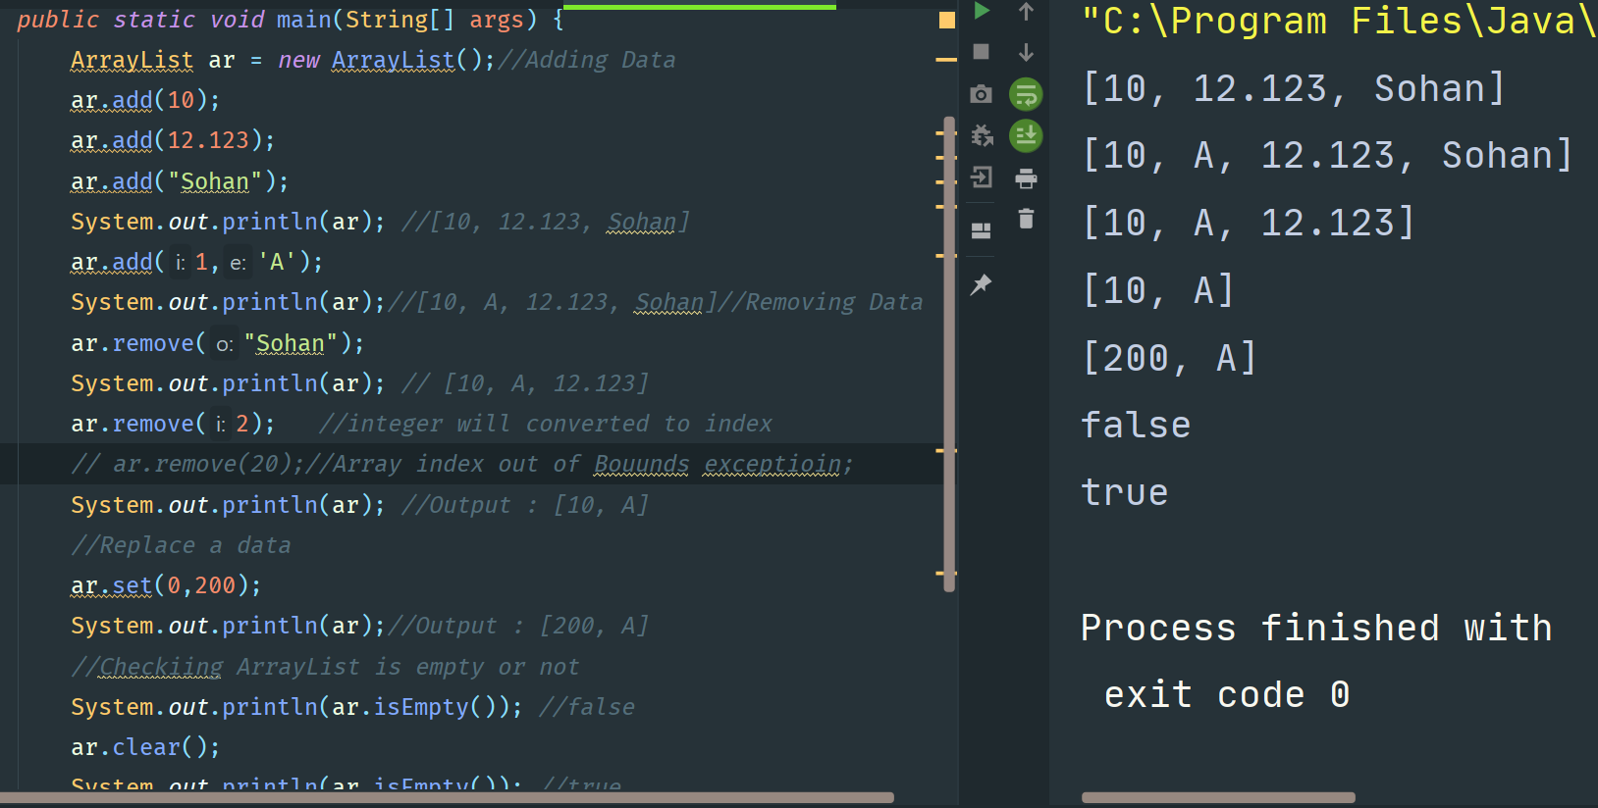

Slide 19
ArrayList Vs Vector class
ArrayList Class | Vector Class
1. Methods are non-synchronize | 1. Methods are synchronoze
2. At a time multiple thread are allowed so it is not thread safe. | 2. At a time multiple thread are not allowed so it is thread safe.
3. Relatively performance is high. | 3. Relatively performance is low.
4. It is version 1.2(Not a Legacy class). | 4. It is version 1.0(Legacy class).

Slide 20
How to get synchronize ArrayList?
With the help of using methods
public static List synchronizeList( List L);
Ex- ArrayList a = new ArrayList();
List a1 = Collections.synchronizeList(a);
Same approach for Set and Map classes.
public static Set synchronizeSet( Set S);
public static Map synchronizeMap( Map M);

Slide 21
LinkedList Class
When we need LinkedList ?
If our frequent operation is insertion or deletion in
the middle.
When linkedList is prohibited ?
If our operation is retrieval operation .

Slide 22
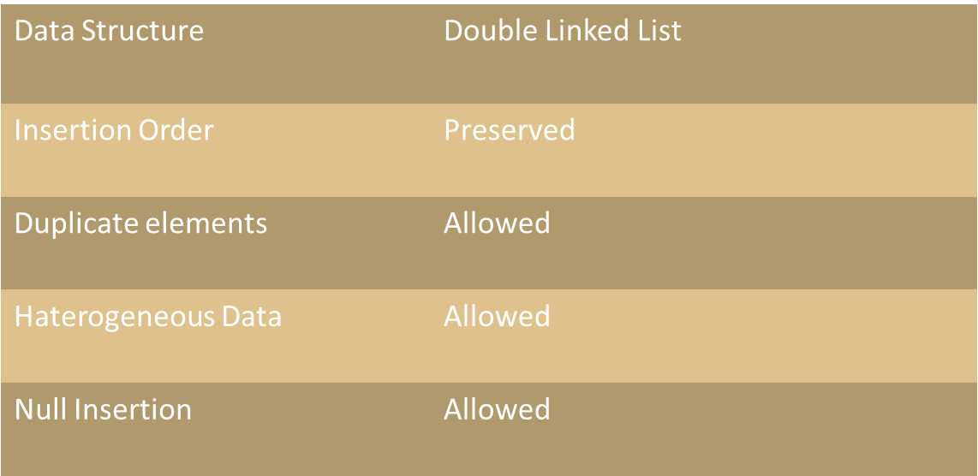
LinkedList Class : Properties

Slide 23
LinkedList Class : Methods
1. Void addFirst ();
2. Void addLast ();
3. Object getFirst ();
4. Object getLast ();
5. Object removeFirst ();
6. Object removeLast ();

Slide 24
LinkedList Class : Constructor
There are two constructor in LinkedList Class
LinkedList() Constructs an empty list.
LinkedList(Collection<? extends E> c) Constructs a list containing the elements of the specified collection, in the order they are returned by the collection's iterator.

Slide 25
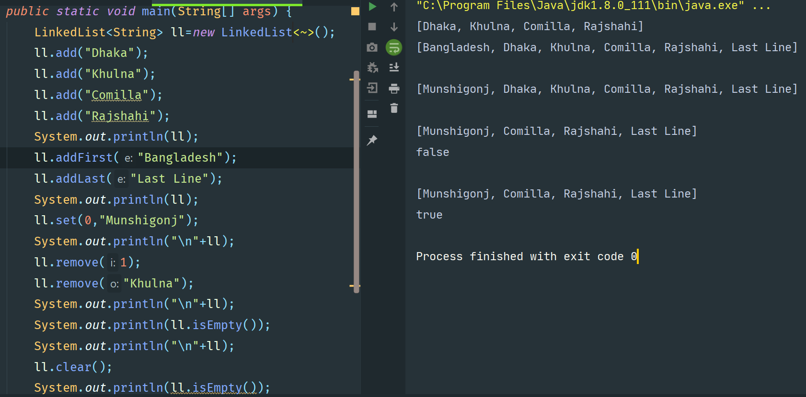
LinkedList Class : Example

Slide 26
Vector Class : Properties
1. Heterogeneous Data | Allowed
2. Null Value | Can Contain Null Value
3. Duplicates Value | Duplicates are allowed.
4. Insertion ordered | Insertion ordered are preserved.
5. Methods | Non synchronized.
6. Data structure | Double Linkedlist.

Slide 27
Vector Class : Methods
1. addElement (Object o); | 6. Object firstElement ( );
2. removeElement (Object o); | 7. Object lastElement ( );
3. Remove ElementAt (int index); | 8. int size( );
4. RemoveAllElements ( ); | 9. int capacity( );
5. Object ElementAt (int index); | 10. Enumeration elements( );

Slide 28
Vector Class : Constructor
Constructor and Description
Vector() Constructs an empty vector so that its internal data array has size 10 and its standard capacity increment is zero.
Vector(Collection<? extends E> c) Constructs a vector containing the elements of the specified collection, in the order they are returned by the collection's iterator.
Vector(int initialCapacity) Constructs an empty vector with the specified initial capacity and with its capacity increment equal to zero.
Vector(int initialCapacity, int capacityIncrement) Constructs an empty vector with the specified initial capacity and capacity increment.

Slide 29
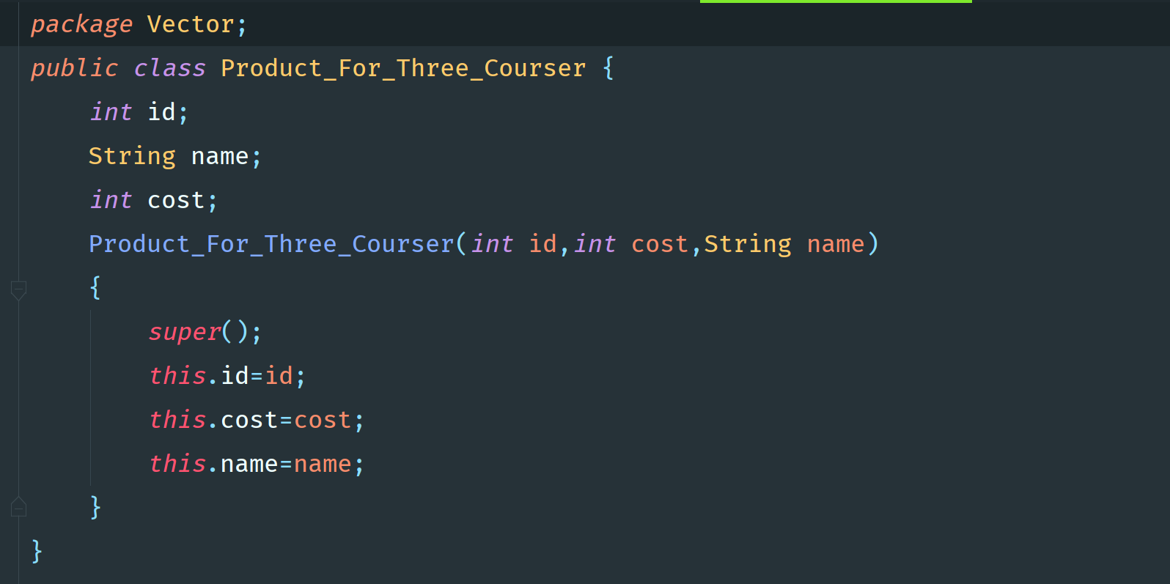
Vector Class : Example

Slide 30
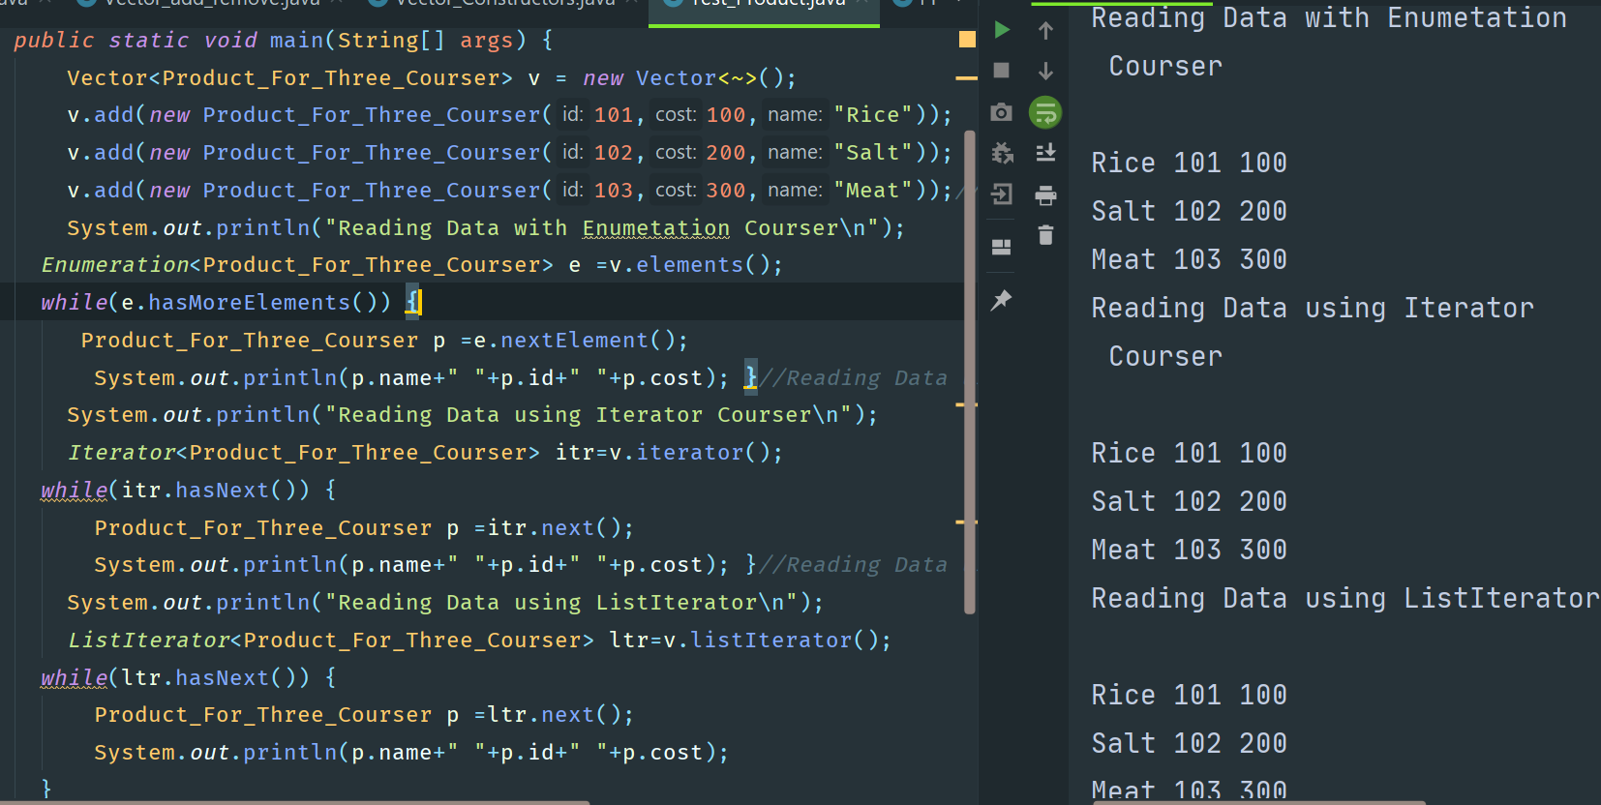
Vector Class : Example

Slide 31
Stack Class : Methods and Constructor
1. Object push (Object obj)
2. Object pop ( )
3. Object search (Object obj)
4. Object peek ( )
Constructor and Description
Stack()Creates an empty Stack.

Slide 32
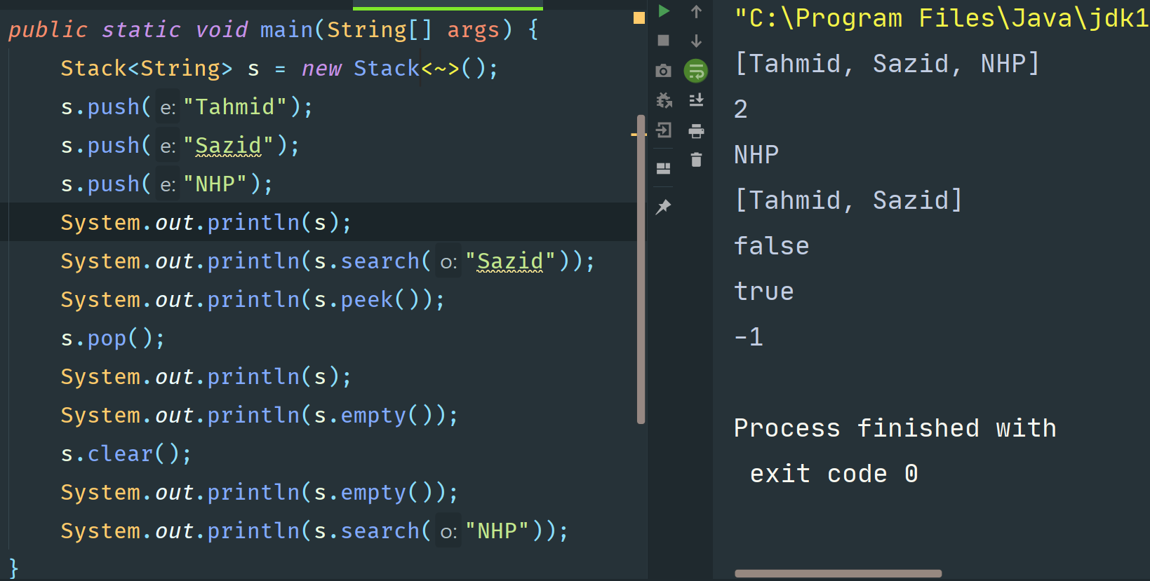
Stack Class : Example

Slide 33
(3) Set interface
Child interfaces of collection
1.Duplicate are not allowed
2.Insertion order is not preserved
Implementation Classes of Set interfaces
1.HashSet(Version 1.2)
2.LinkedHashSet(Version 1.4)

Slide 34
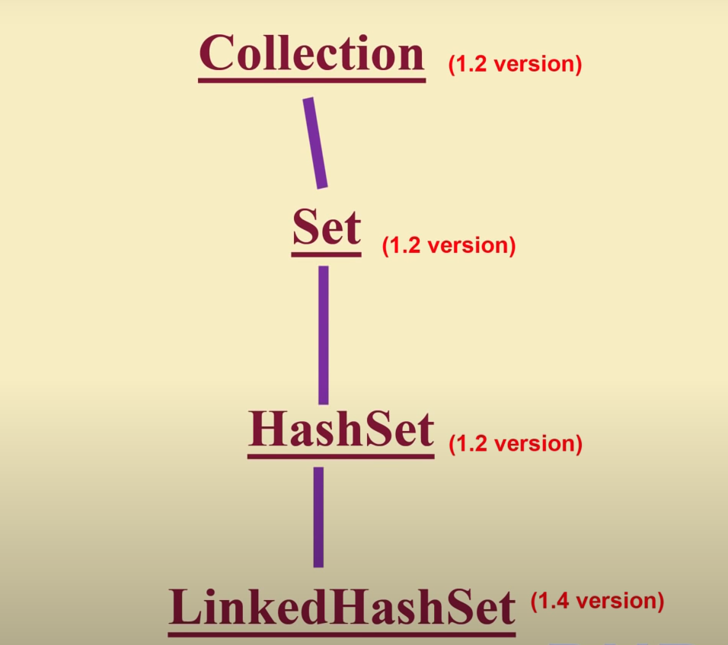
(3) Set interface

Slide 35
When we should use set interface ?
Duplicate are not allowed
2. Insertion order is not preserved
It is a child interface of Collection interface.
What are the implementation classes of Set Interface ?
1.HashSet class.
There is no special method for this interface but it can use Collection interface methods.

Slide 36
HashSet Class : Properties
1. Heterogeneous Data | Allowed
2. Null Value | Can Contain Null Value
3. Duplicates Value | Duplicates are not allowed.
4. Insertion ordered | Insertion ordered are not preserved.
5. Data structure | Hash Table .

Slide 37
HashSet : Constructor
Constructor and Description
HashSet() Constructs a new, empty set; the backing HashMap instance has default initial capacity (16) and load factor (0.75).
HashSet(int initialCapacity) Constructs a new, empty set; the backing HashMap instance has the specified initial capacity and default load factor (0.75).
HashSet(int initialCapacity, float loadFactor) Constructs a new, empty set; the backing HashMap instance has the specified initial capacity and the specified load factor.
HashSet(Collection<? extends E> c) Constructs a new set containing the elements in the specified collection.

Slide 38
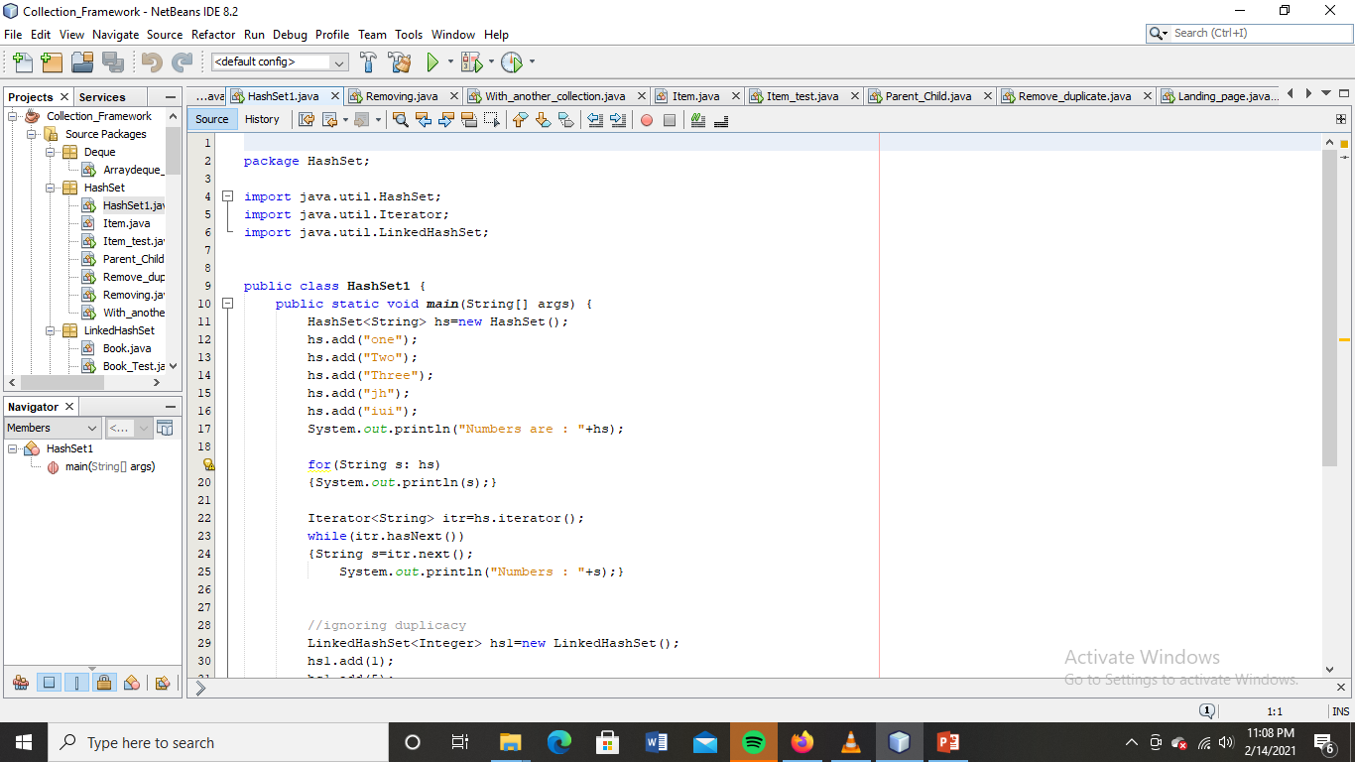
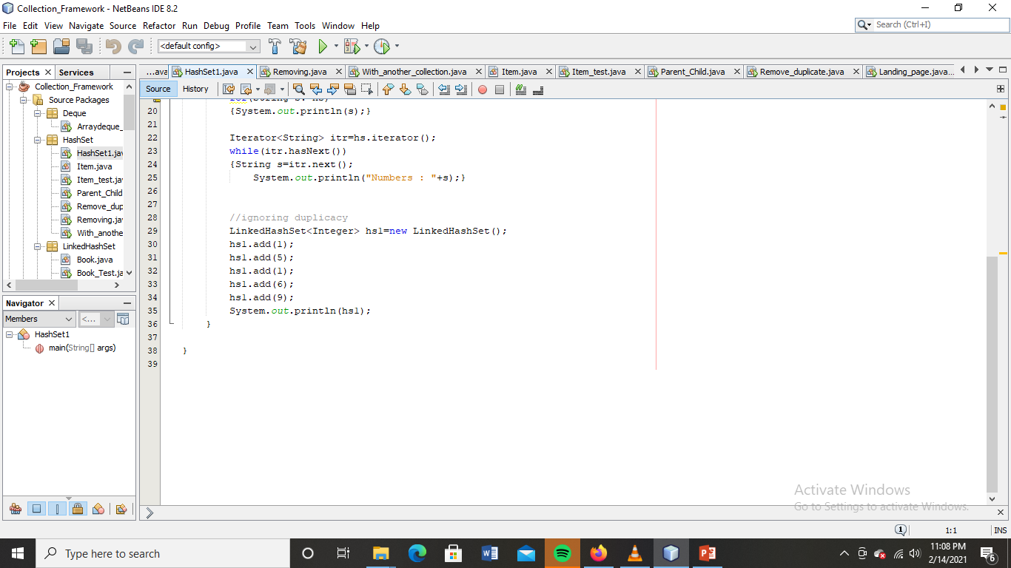
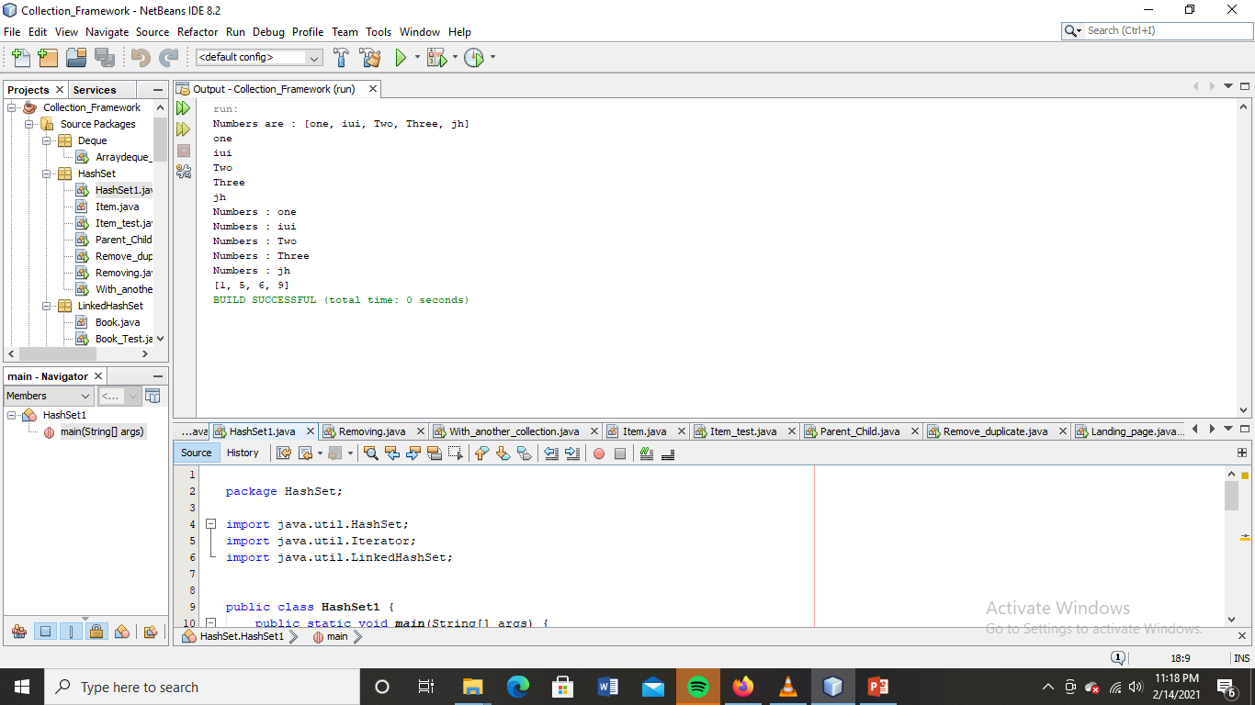
HashSet : Example

Slide 39
LinkedHashSet : Class
It is a child class of HastSet.
In the LinkedHashSet insertion order is preserved.
For cache based application LinkedHashSet is usefull.

Slide 40
LinkedHashSet Class : Properties
1. Heterogeneous Data | Allowed
2. Null Value | Can Contain Null Value
3. Duplicates Value | Duplicates are not allowed.
4. Insertion ordered | Insertion ordered are preserved.
5. Data structure | Hash Table and LinkedList mixed.

Slide 41
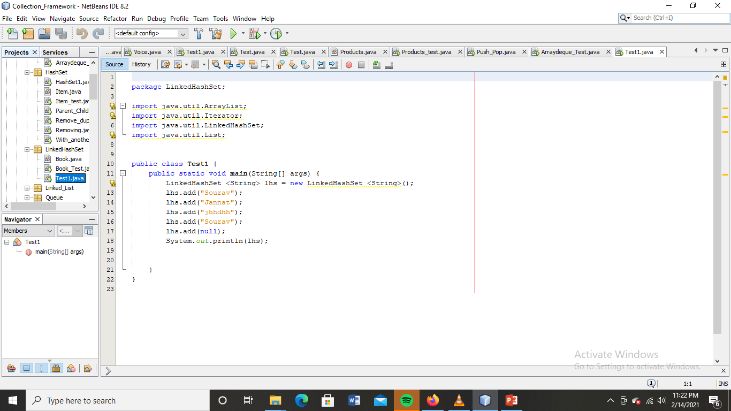
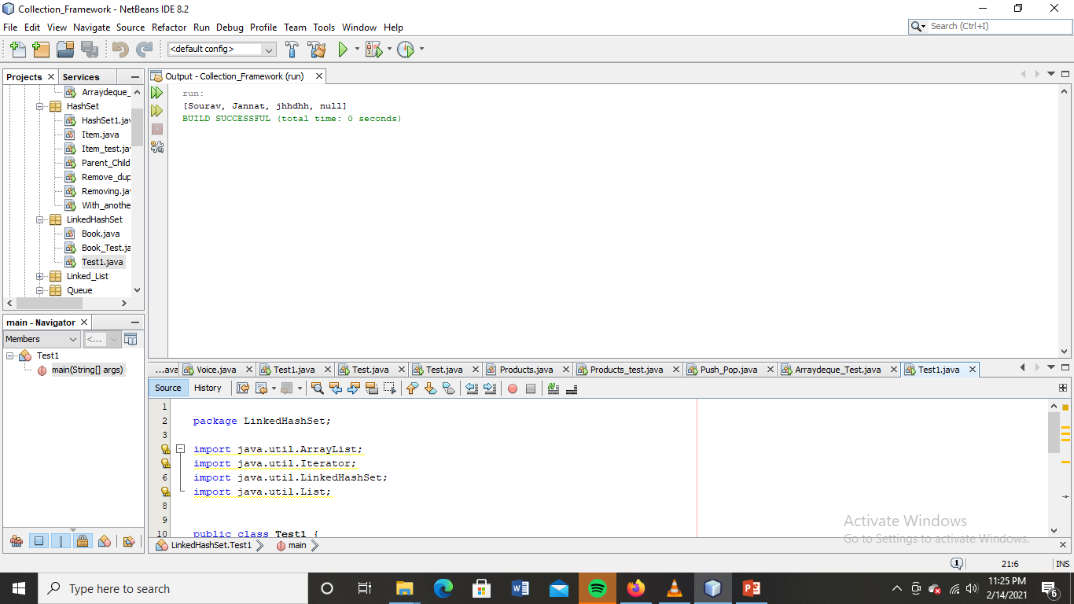
LinkedHashSet Class : Example

Slide 42
(4) SortedSet Interface
Child interface of Set interface
1.Duplicates are not allowed
2.Object are preserved in some sorting order.

Slide 43
SortedSet : Interface
It is a child interface of Set interface.
Here Object are preserved according some sorting order.
Methods of this interface :
1.Object first ( );
2.Object last ( );
3.SortedSet headSet (Object o);
4.sortedSet tailSet (Object 0);
5.sortedSet subSet (Object o1 , Object o2)
6.Comparator comparator ( );

Slide 44
(5) NavigableSet Interface
It is a child interface of sorted set.
It define several methods for navigation purpose like, what is previous elements, next element?
Implementation class of Navigableset is Treeset class.

Slide 45
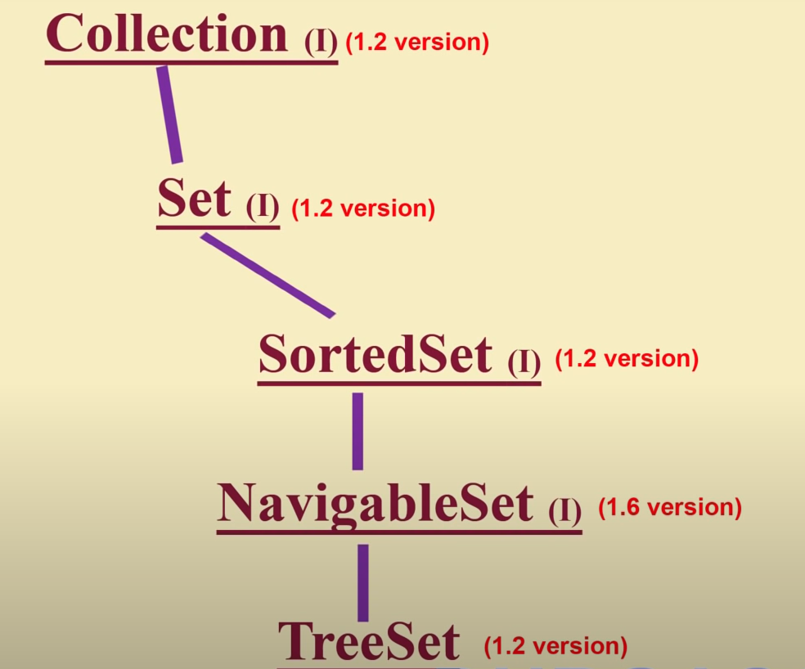
NavigableSet Interface

Slide 46
Implementation class of NavigableSet Interface
TreeSet class is the implementation class NavigableSet interface.
1. Heterogeneous Data | Not allowed must be compareable
2. Null Value | Not allowed
3. Duplicates Value | Duplicates are not allowed.
4. Insertion ordered | Insertion ordered are not preserved.
5. Data structure | Hash Table and LinkedList mixed.

Slide 47
TreeSet : Constructor
Constructor and Description
TreeSet() Constructs a new, empty tree set, sorted according to the natural ordering of its elements.
TreeSet(Collection<? extends E> c) Constructs a new tree set containing the elements in the specified collection, sorted according to the natural ordering of its elements.
TreeSet(Comparator<? super E> comparator) Constructs a new, empty tree set, sorted according to the specified comparator.
TreeSet(SortedSet<E> s) Constructs a new tree set containing the same elements and using the same ordering as the specified sorted set.

Slide 48
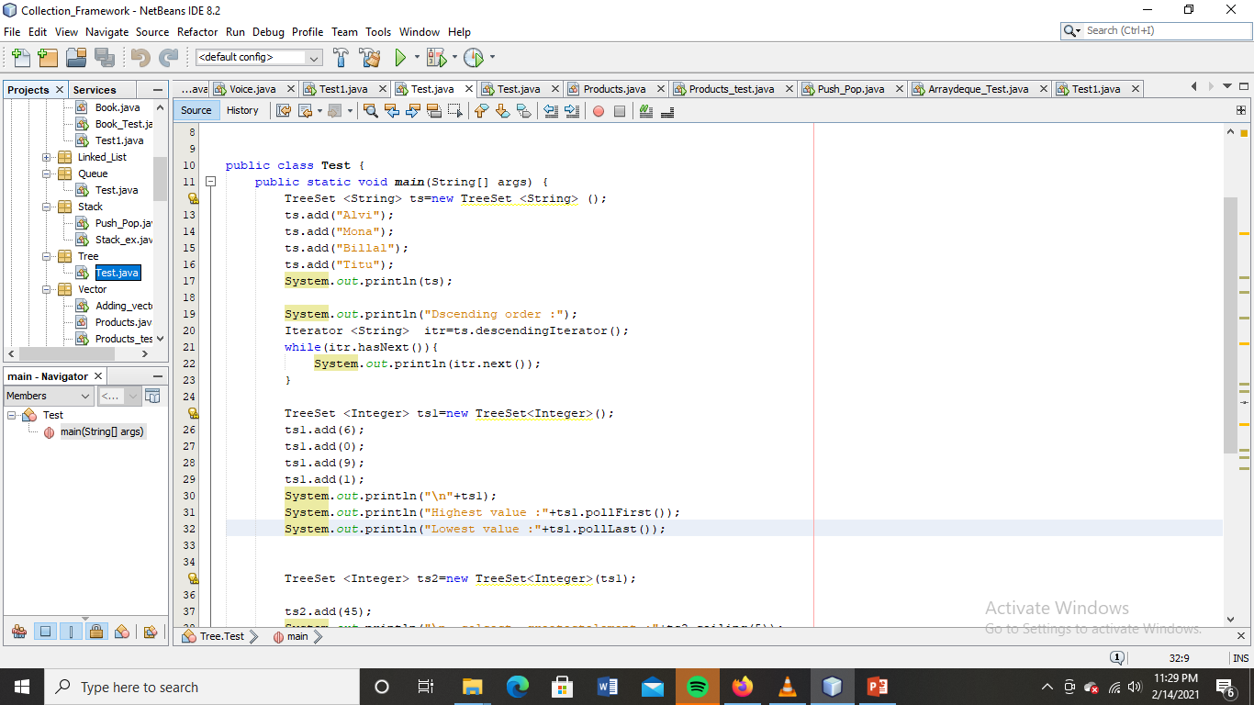
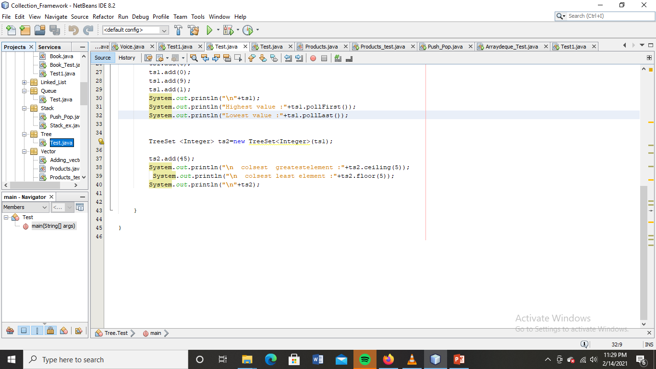
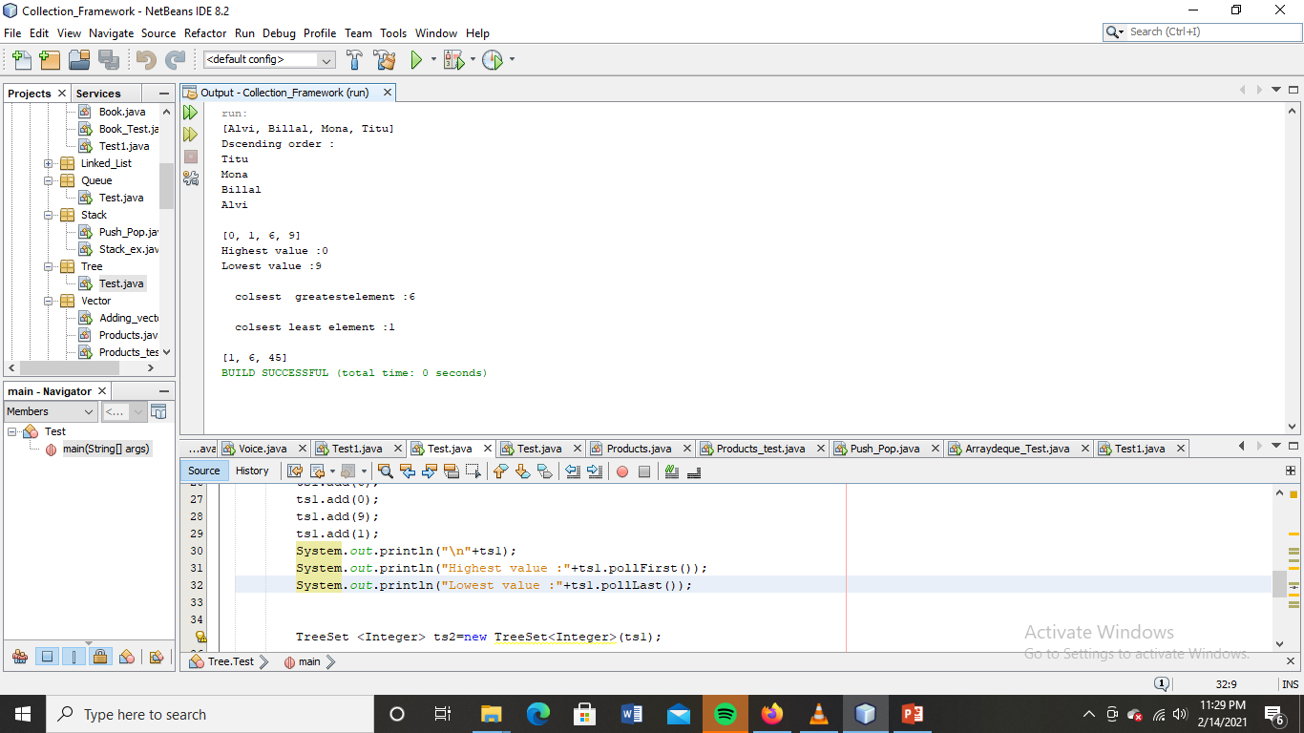
SortedSet : Exaxmple(TreeSet)

Slide 49
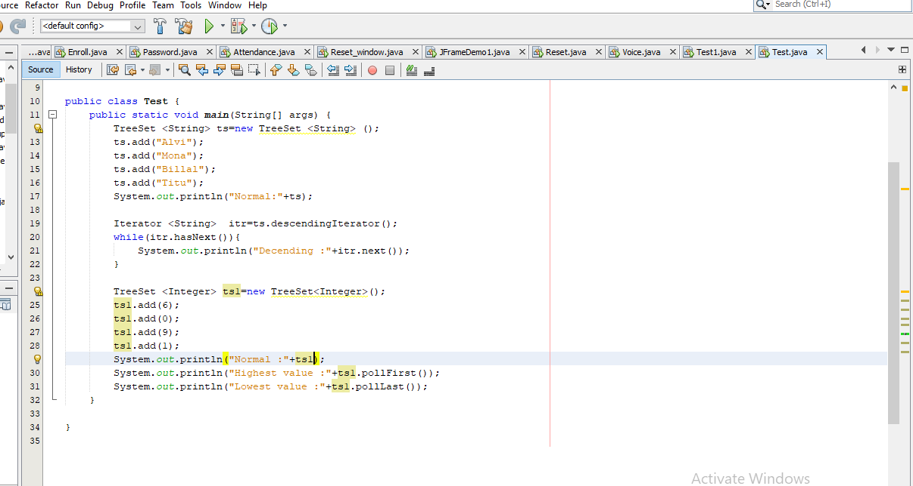
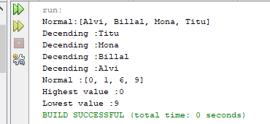
SortedSet : Exaxmple(TreeSet)

Slide 50
(6) Queue Interface
It is a child interface of Collection
If we want to preserve data as first in first out
The implementation classes of Queue interface
1.PriorityQueue
2.BlockingQueue
3.LinkedBlockingQueue
4.PriorityBlockingQueue

Slide 51
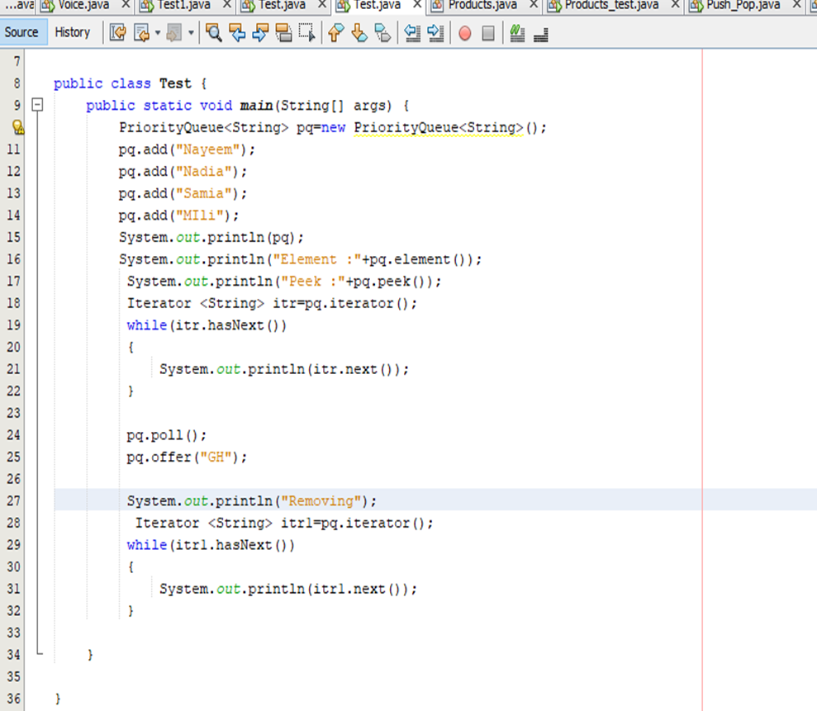
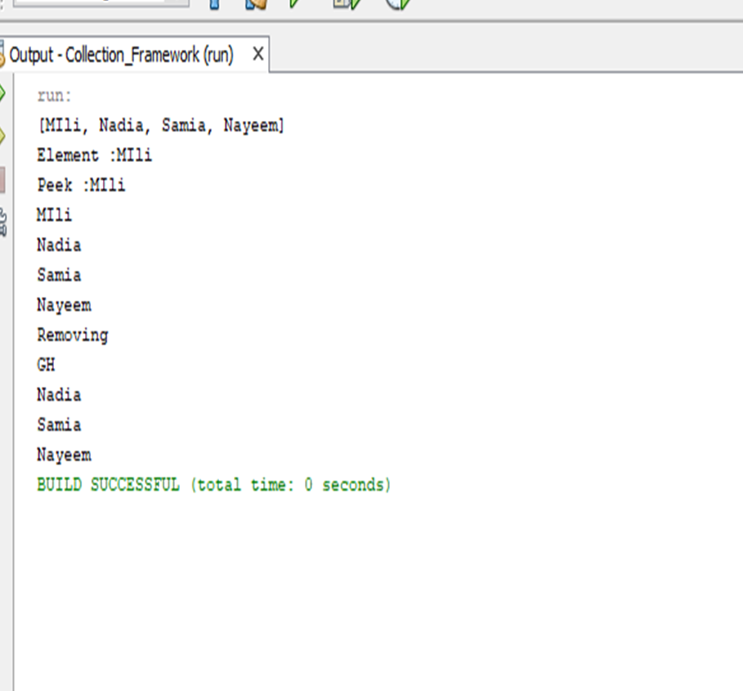
Queue example :

Slide 52
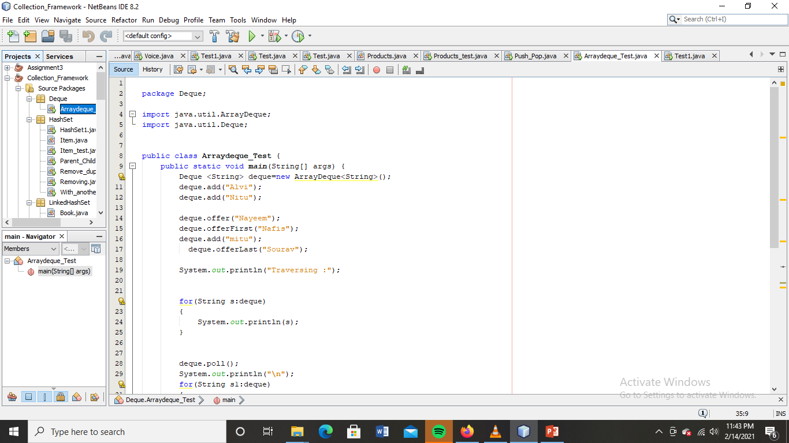
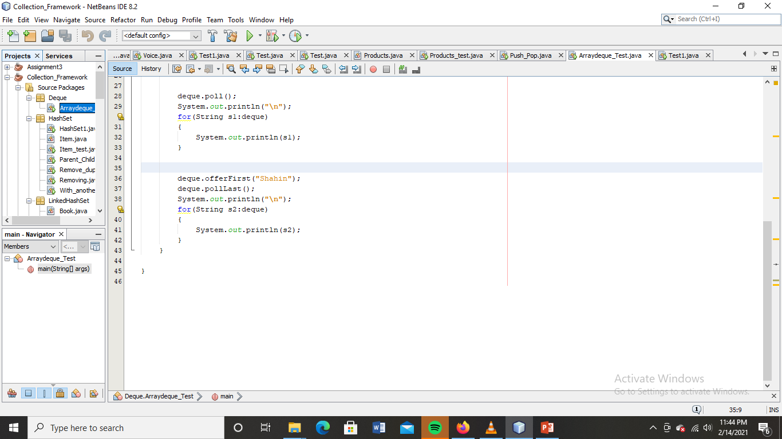
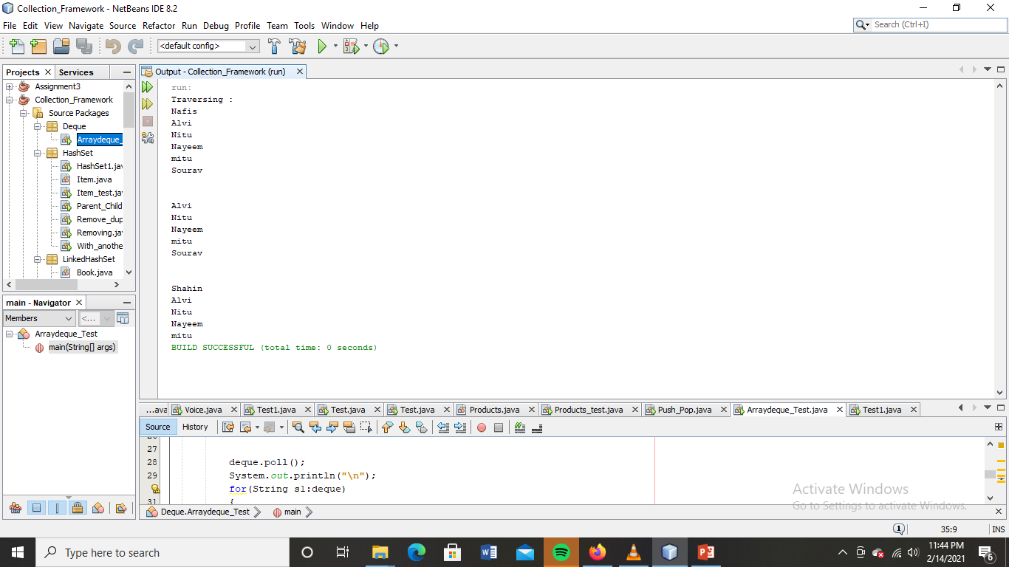
Deque Example :

Slide 53
Map Interface
If we want to represent objects as key value pair Map interface.
Key can’t be duplicate but value can be
Id | Name
101 | Debnath
102 | Arman
103 | Alamgir

Slide 54
Map Interface :Heirarchy

Slide 55
HashMap
Important points:-
HashMap class is found in the java.util package.
Java HashMap contains values based on the key.
Java HashMap contains only unique keys.
Java HashMap may have only one null key and multiple null values.
Java HashMap maintains no order.
The initial default capacity of Java HashMap class is 16 with a load factor of 0.75.

Slide 56
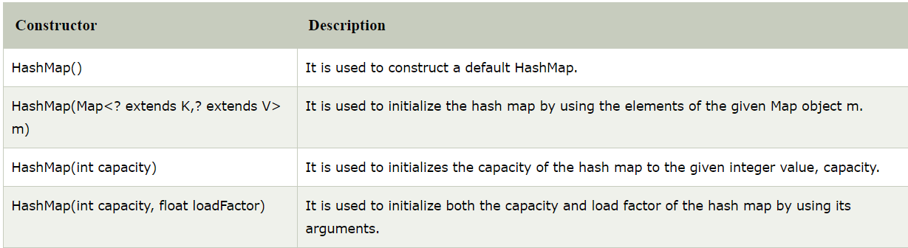
HashMap : Constructor

Slide 57
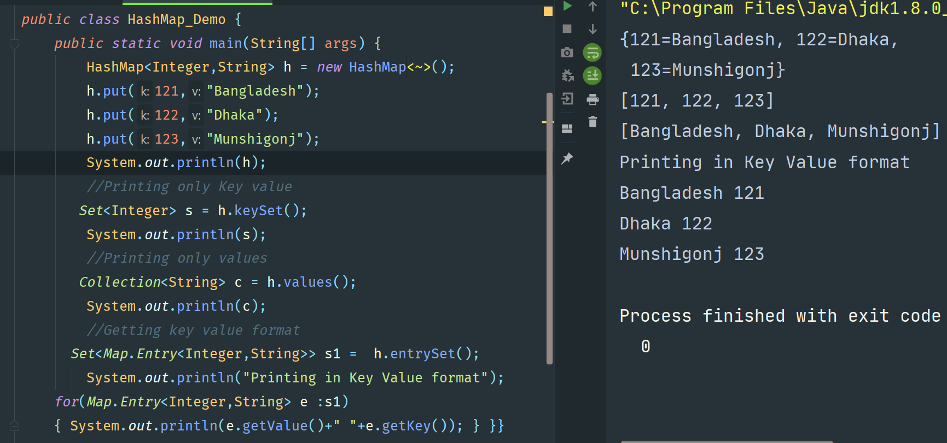
HashMap : Example

Slide 58
LinkedHashMap
Important points:-
Java LinkedHashMap contains values based on the key.
Java LinkedHashMap contains unique elements.
Java LinkedHashMap may have one null key and multiple null values.
Java LinkedHashMap maintains insertion order.
The initial default capacity of Java HashMap class is 16 with a load factor of 0.75.

Slide 59
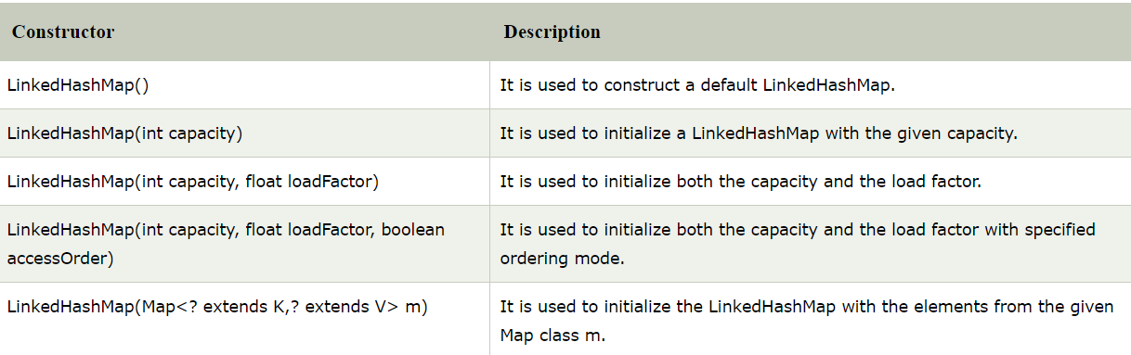
LinkedHashMap : Constructor

Slide 60
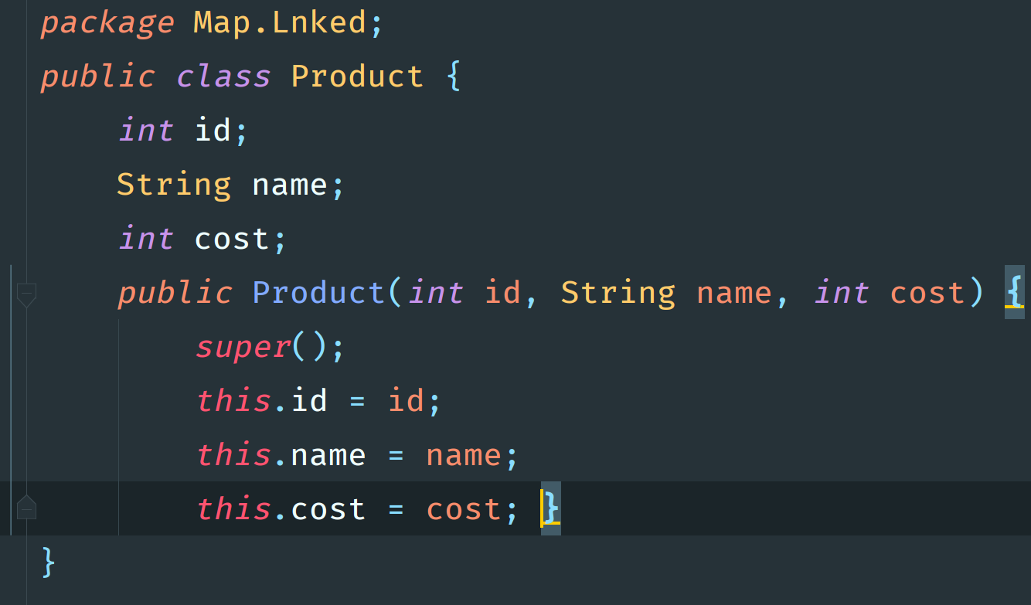
LinkedHashMap : Example

Slide 61
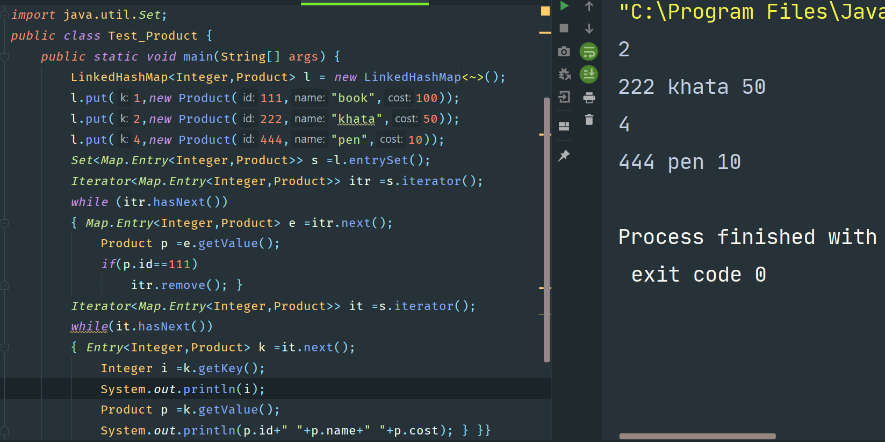
LinkedHashMap : Example

Slide 62
(8) SortedHashMap Interface
Child interface of Map Interface
1.In key value system
2.Object are preserved in a sorted way.

Slide 63
(9) NavigableMap Interface
It is a child interface of SortedHashMap
It contains some utility methods for navigation
TreeMap Class is the implementation class.

Slide 64
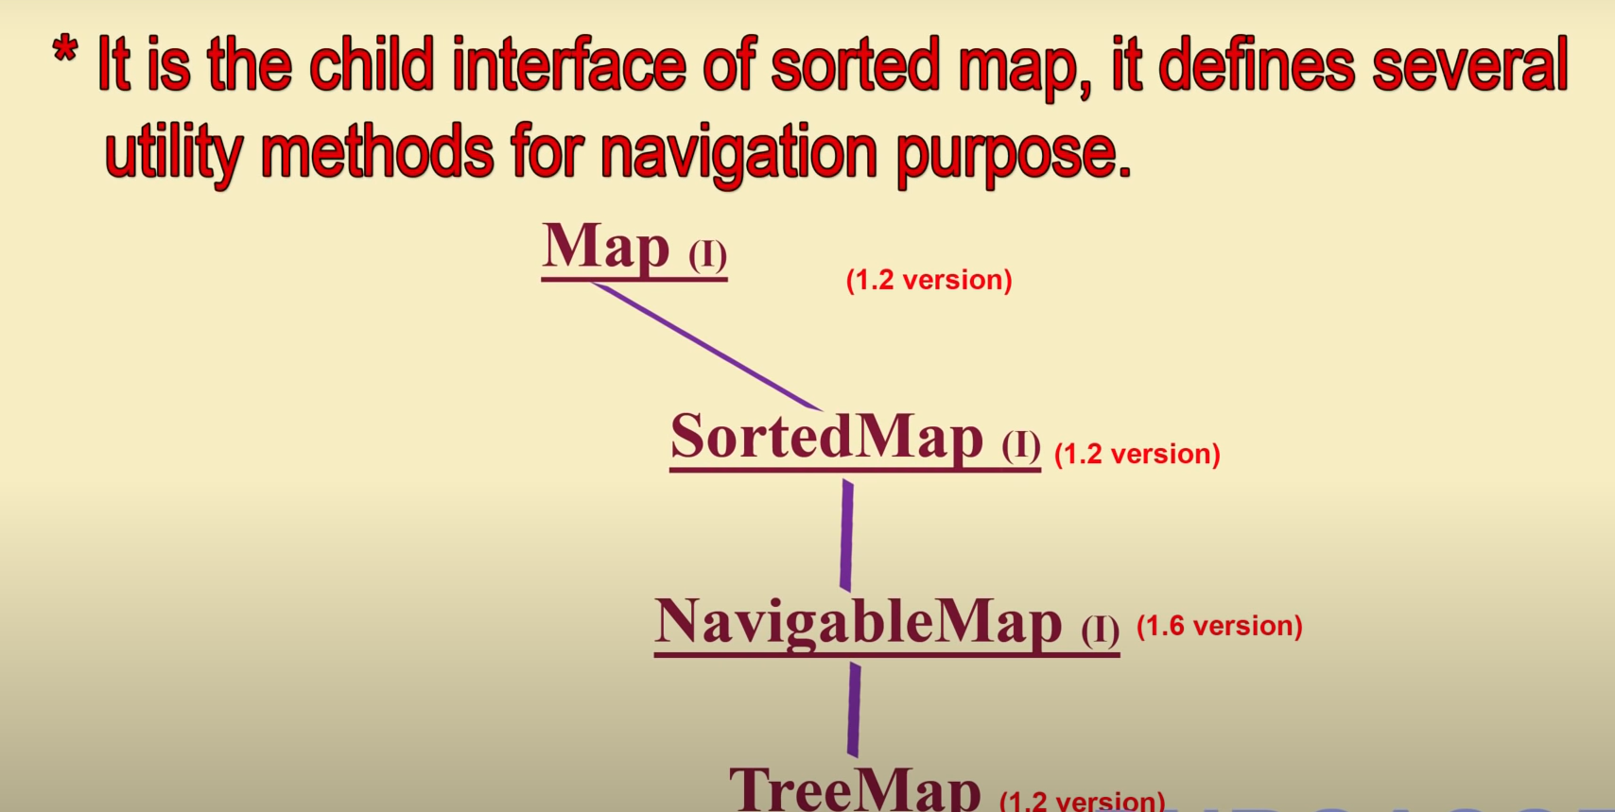
(9) NavigableMap Interface

Slide 65
TreeMap : Class
Data must be homogeneous .
Must implements Comparable interface .
The data are sorted based on key data.
TreeMap maintains ascending order.
TreeMap cannot have a null key but can have multiple null values.

Slide 66
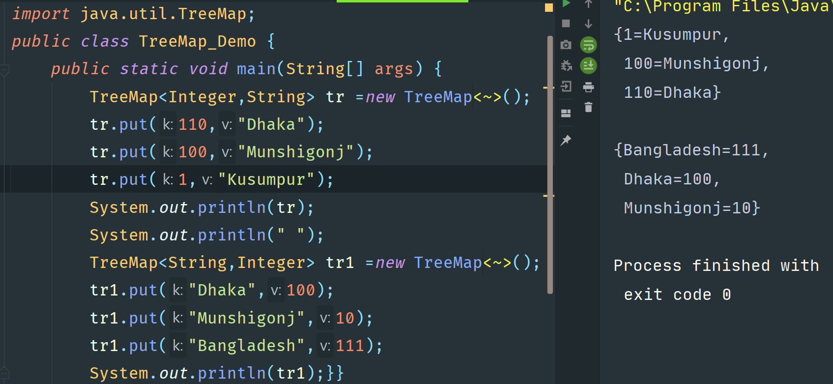
TreeMap : Example

Slide 67
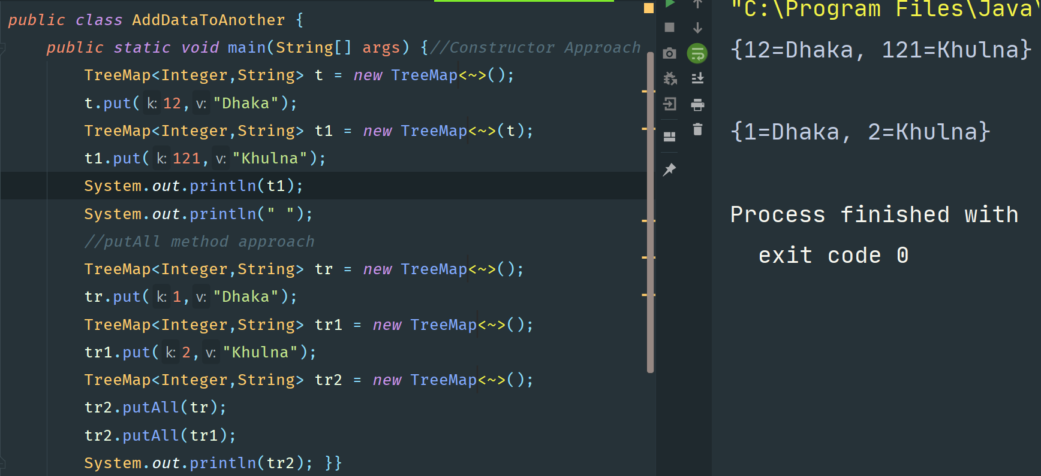
TreeMap : Example 2

Slide 68
Hashtable class
Hashtable is a legacy class, which maps keys to values. It inherits Dictionary class and implements the Map interface.
Important Points :-
A Hashtable is an array of a list. Each list is known as a bucket. The position of the bucket is identified by calling the hashcode() method. A Hashtable contains values based on the key.
Java Hashtable class contains unique elements.
Java Hashtable class doesn't allow null key or value.
Java Hashtable class is synchronized.
The initial default capacity of Hashtable class is 11 whereas loadFactor is 0.75.

Slide 69
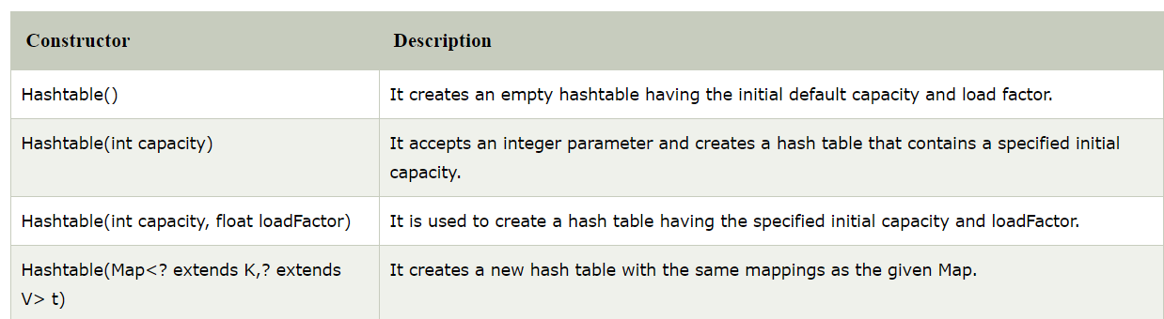
Hashtable class : Constructors

Slide 70
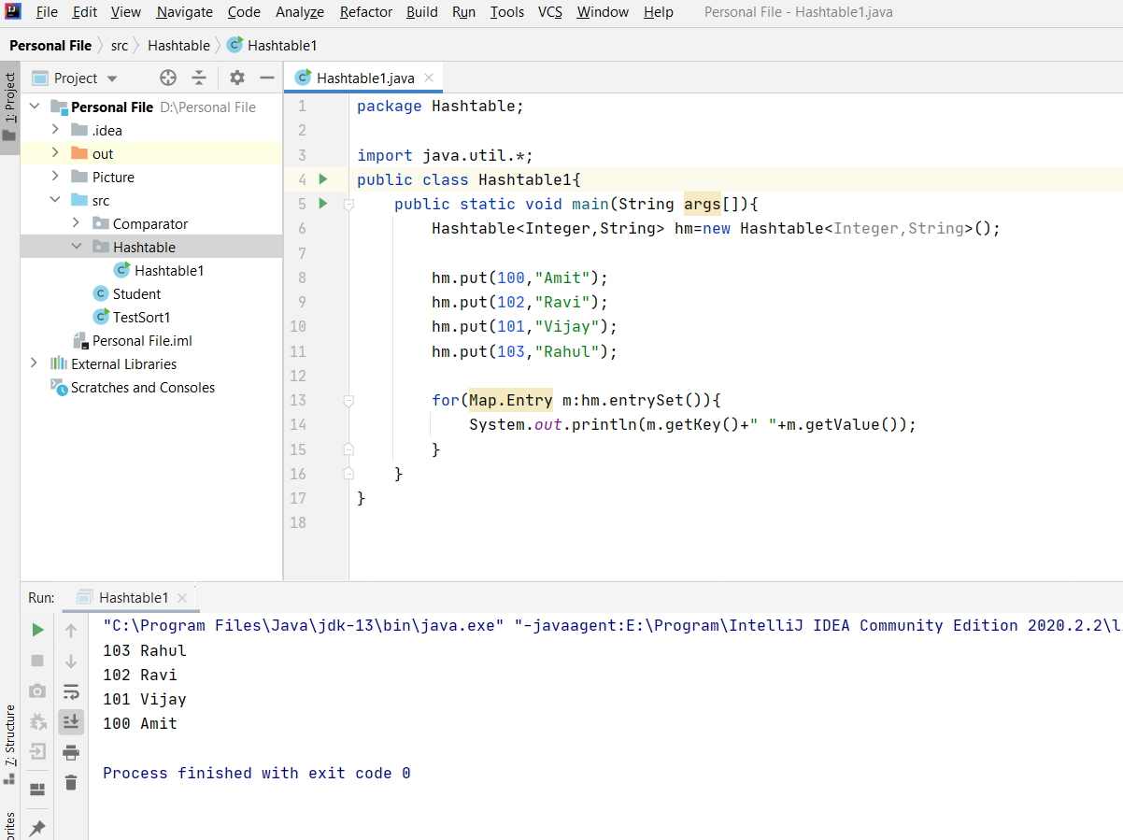
Hashtable class : Example

Slide 71
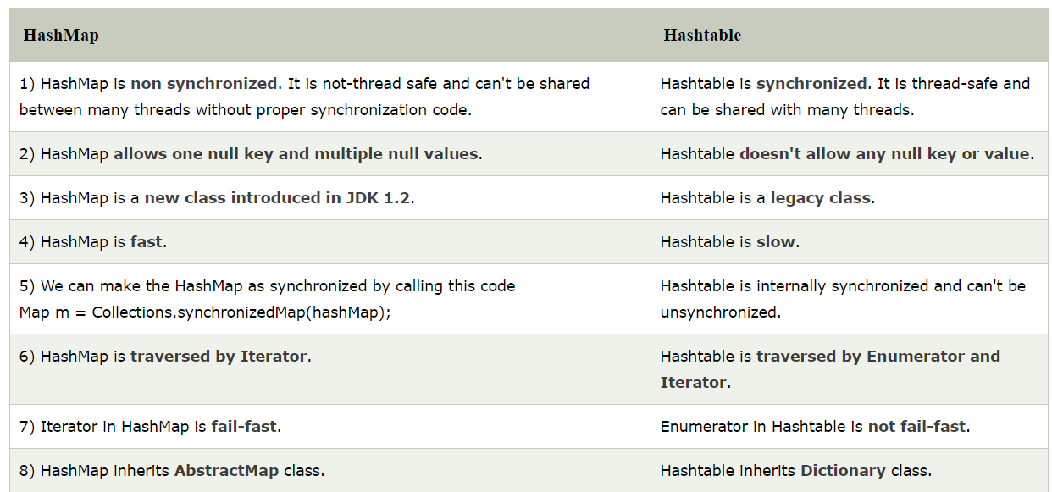
HashMap VS Hashtable

Slide 72
Coursers
If we want to get object one by one then we need Coursers
To traverse the collection
Access the Data Elements
Delete the Element
There are three types of coursers
1.Enumeration
2.Iterator
3.ListIterator

Slide 73
Enumeration Courser
It is used to get components of inheritance collections (Vector, Hashtable). with the help of elements () method.
Ex- Enumeration e = v.elements () ; [ v = any legacy class object ]
Methods :
1. public boolean hasmoreElements ();
2. public Object nextElement ();
It is only for legacy class and it can perform only read operation .

Slide 74
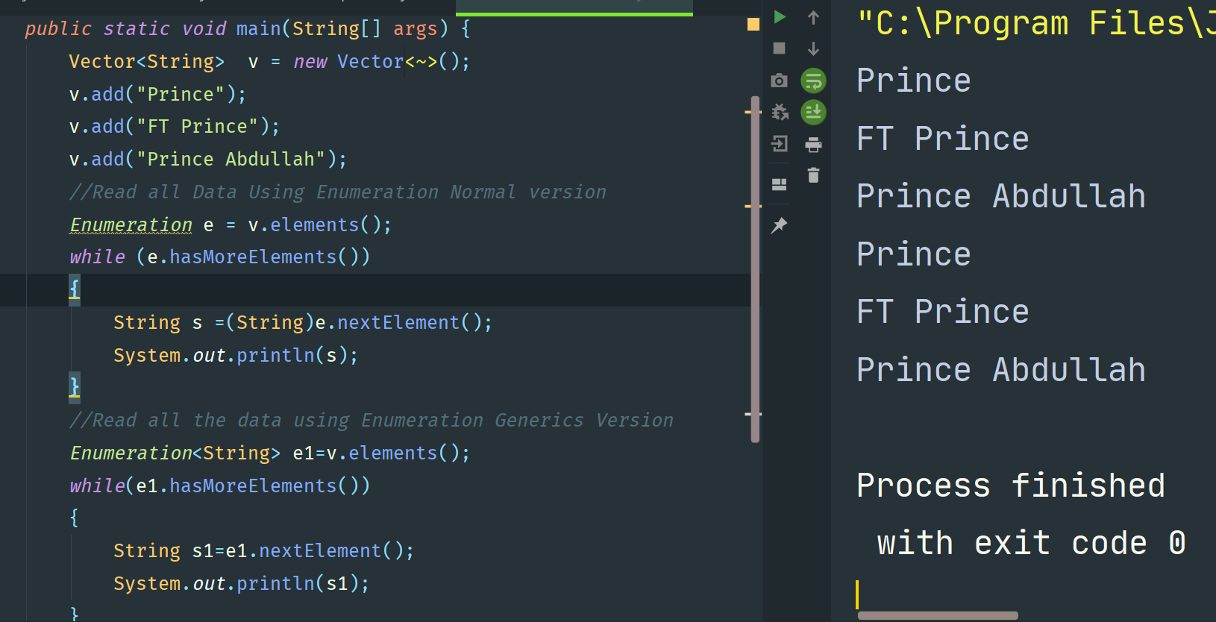
Enumeration : Example

Slide 75
Enumeration Courser
Limitations of Enumeration:-
It is for a legacy class, and hence not a universal Java iterator.
The operations of removing cannot be performed.
Only forward iteration is possible.

Slide 76
Iterator Courser
How to get Iterator ?
With the help of method public Iterator iterator ( ) ;
Ex- Iterator i = C.iterator ( ) ; [ C = any Collection object ]
Mehods :
1. public boolean hasnext ( ) ;
2. public Object next ( ) ;
3. public void remove ( ) ;
It is a universal courser and can perform both read and remove operetion.

Slide 77
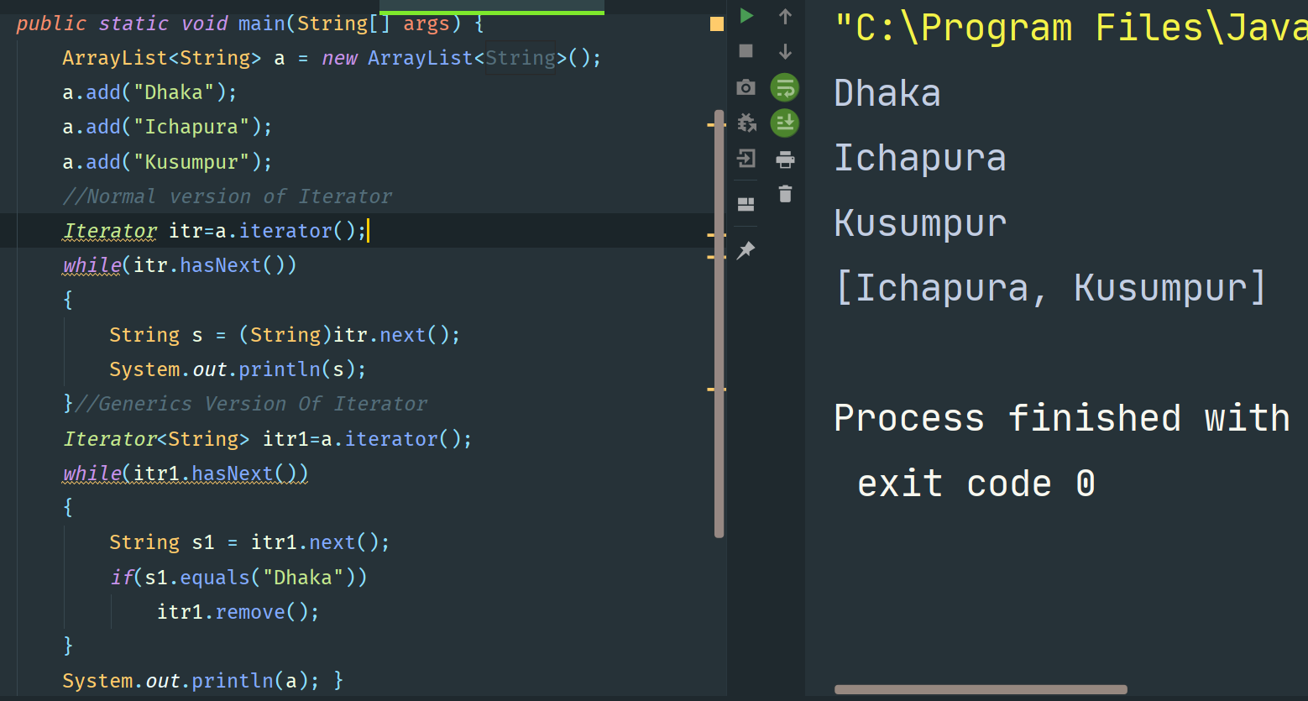
Iterator Example

Slide 78
Iterator Courser
Limitations:-
Iteration of only forward direction is possible.
Replacement and addition not possible.

Slide 79
ListIterator Courser
How to get ListIterator ?
public ListIterator listIterator ( );
Ex- ListIterartor ltr = L.listIterator ( ); [ L = any list object ]
Forward direction | Backward direction | Extra Qualities
1. public boolean hasnext ( ) ; | 1. public boolean hasprevious ( ); | 1. Public void remove ( ) ;
2. public Object next ( ) ; | 2. public Object previous ( ) ; | 2. Public void add (Object o) ;
3. public int nextIndex ( ) ; | 3. public int previousIndex ( ) ; | 3. Public void set (Object o) ;

Slide 80
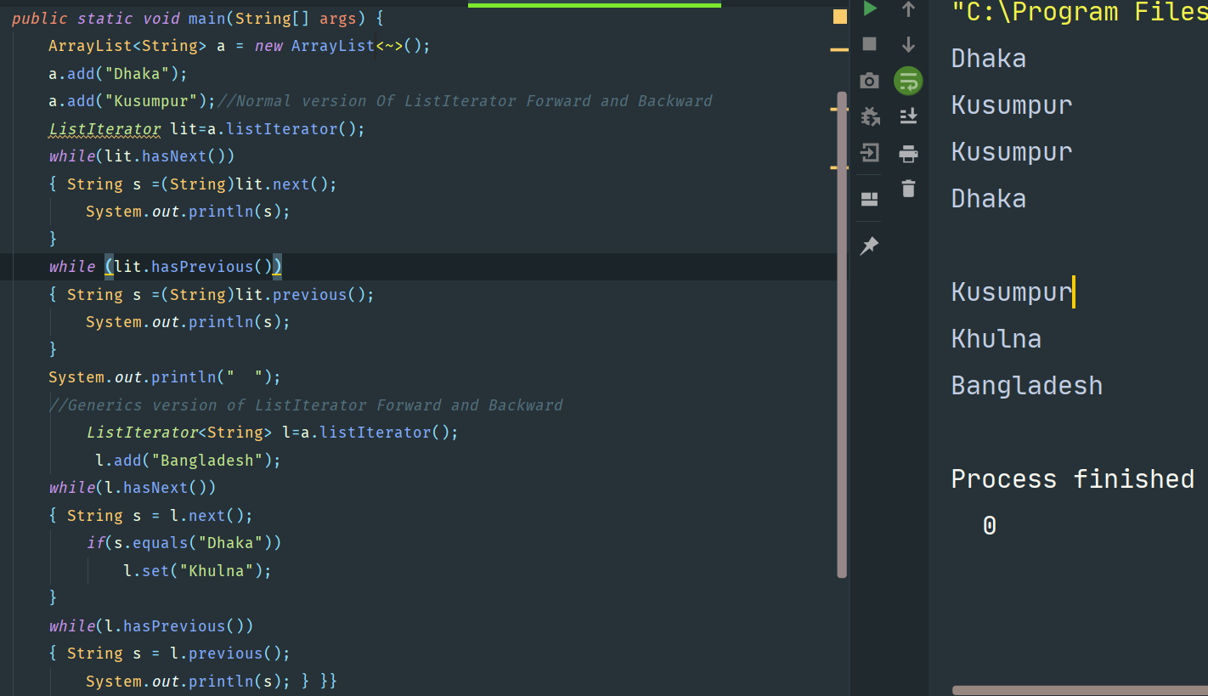
ListIterator Example

Slide 81
ListIterator Courser
Limitation :-
Only applicable to list not to a universal Java iterator.

Slide 82
Comparable interface
Comparable interface is used to order the objects of the user-defined class. This interface is found in java.lang package and contains only one method named compareTo(Object).
public int compareTo(Object obj): It is used to compare the current object with the specified object. It returns
positive integer, if the current object is greater than the specified object.
negative integer, if the current object is less than the specified object.
zero, if the current object is equal to the specified object.

Slide 83
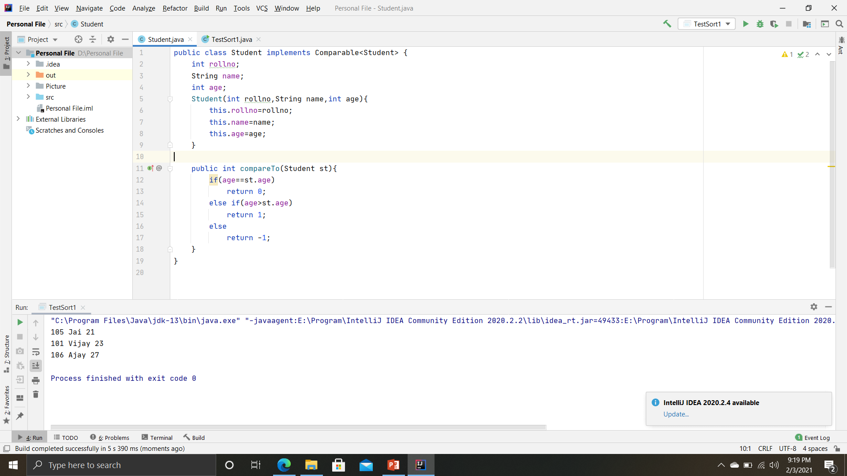
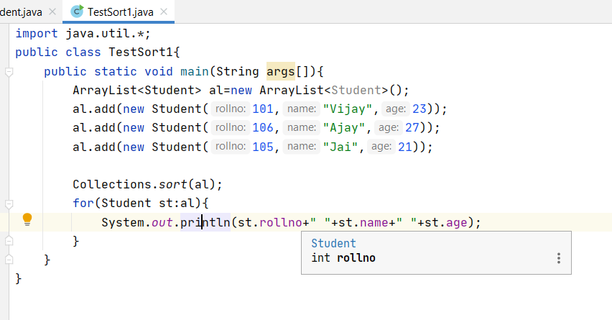
Comparable interface

Slide 84
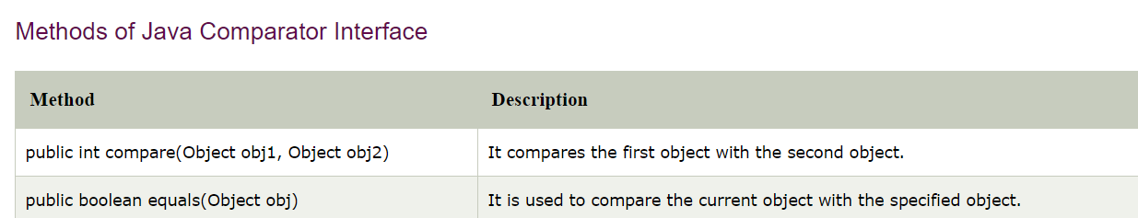
Comparator interface
Comparator interface is used to order the objects of a user-defined class.
This interface is found in java.util package and contains 2 methods compare(Object obj1,Object obj2) and equals(Object element).

Slide 85
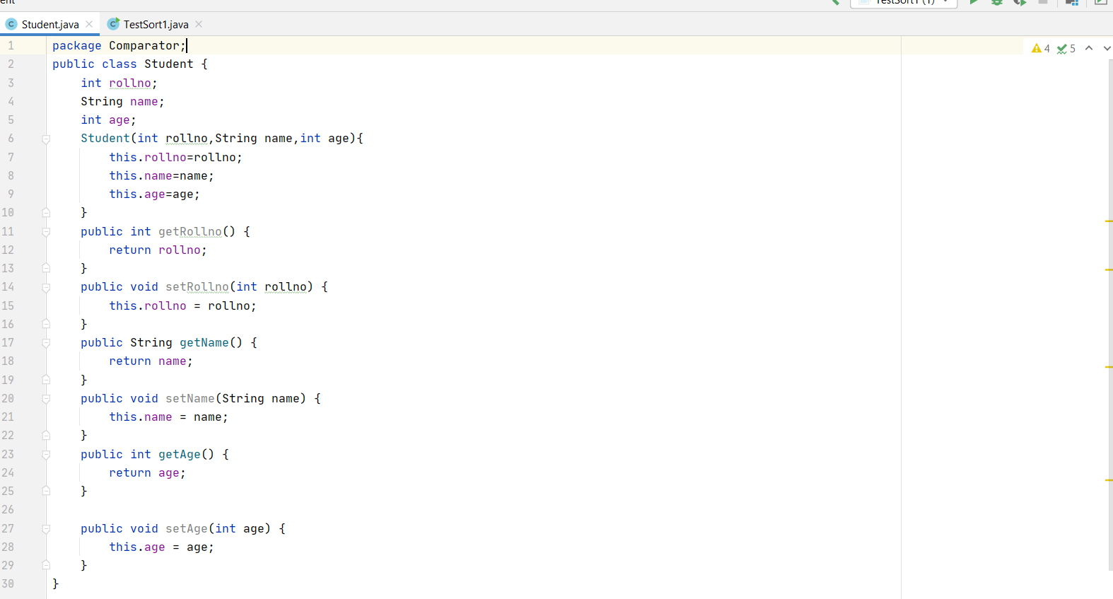
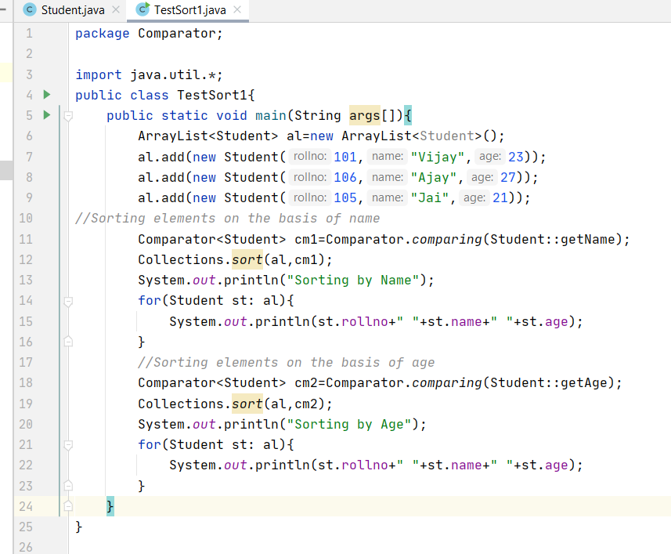
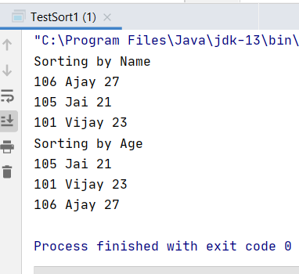
Comparator interface

Slide 86
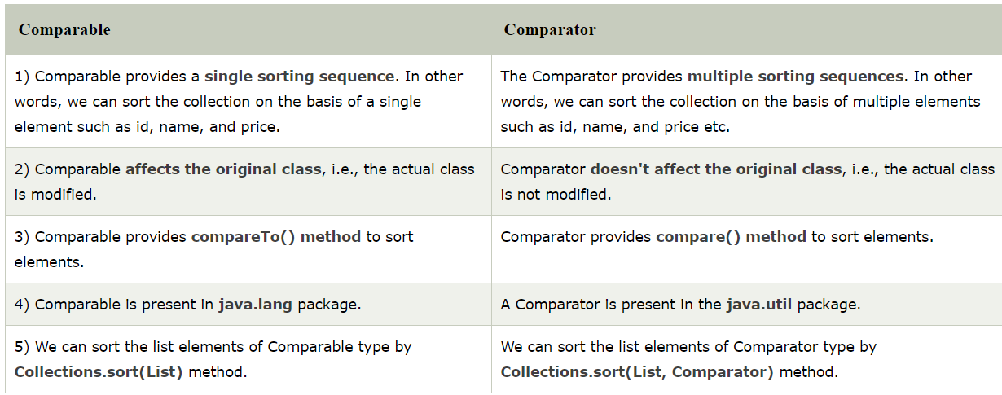
Comparable vs Comparator

Slide 87
Thank You

